Slide 1

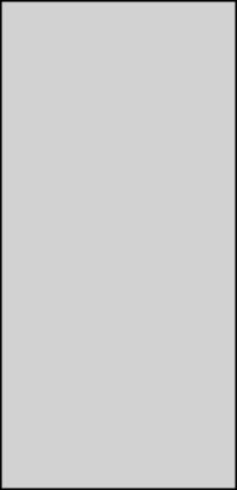
INFORMATION SECURITY
LECTURE 5
Dr. Muhammad Umar Aftab

Slide 2

Secure Coding Practices
  Secure coding pactices include:
  Input validation and sanitization
  Output encoding
  Principle of least privilege
  Secure authentication and session management
  Proper error handling and logging
  Use of parameterized queries (avoid SQL injection)
  Secure password storage (hashing + salting)
  Avoid hardcoded credentials
  Enforce secure communication (TLS/SSL)

Slide 3
Common Software Security Issues
  There are various software security issues and few are listed below:
  Buffer overflows
  SQL injection
  Cross-site scripting (XSS)
  Cross-site request forgery (CSRF)
  Sensitive data exposure
  Security misconfigurations
  Lack of input/output validation
  Weak or custom cryptography

Slide 4
Buffer Overflow
  A buffer overflow, or buffer overrun, occurs when more data is put into a fixed-length buffer than the buffer can handle. The extra information, which has to go somewhere, can overflow into adjacent memory space, corrupting or overwriting the data held in that space.
  A buffer overflow, or buffer overrun, is a common software coding mistake that an attacker could exploit to gain access to your system.
  Buffer is a sequential memory
  Buffer overflow is the common and classic vulnerability.

Slide 5
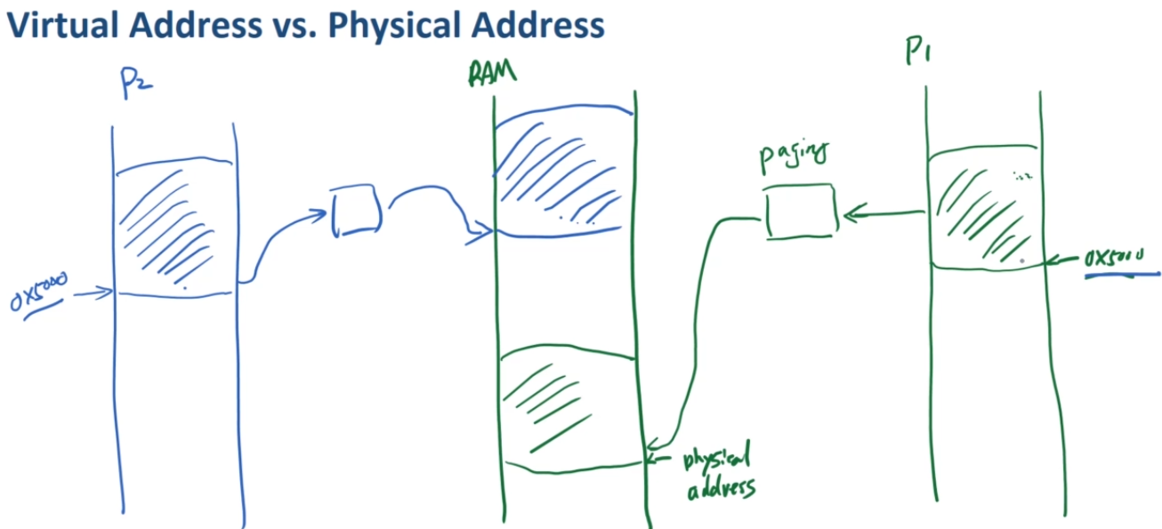
Virtual vs Physical Address Scheme
  For every process, OS allocates block of memory or several blocks of memory for it, to run.
  RAM has physical addresses.
  In a program, if two different processes created P1 & P2.
    OS will allocate physical memory/addresses to them.
    Although processes have virtual address space.
    So, we have a mapping (Paging) between physical and virtual addresses.
    Two processes mapped on two different physical addresses in RAM. (OS will make sure)

Slide 6
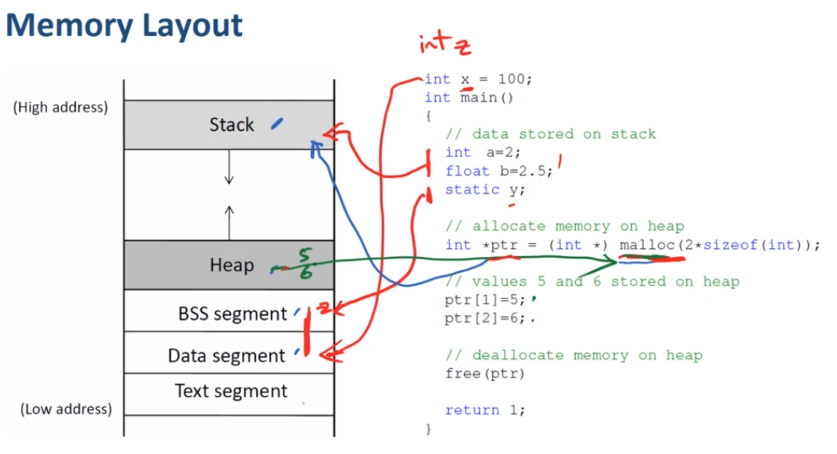
Memory Layout
  This program has different type of data and store in different type of memory locations.
  Text segment is for strings storage.
  If variable is initialized then it will go to data otherwise in BSS segment i.e. z.
  Data segment: global variables i.e. x stores here.
  Stack: Local variable (a,b, ptr)
    Ptr points block of memory
  Those blocks of memory
  are stored in Heap
  BSS Segment: y
Notes:
Static variables are also like global variables but they placed inside the function. They are available lifetime but only inside the function but global variables are available outside the function as well.

Slide 7
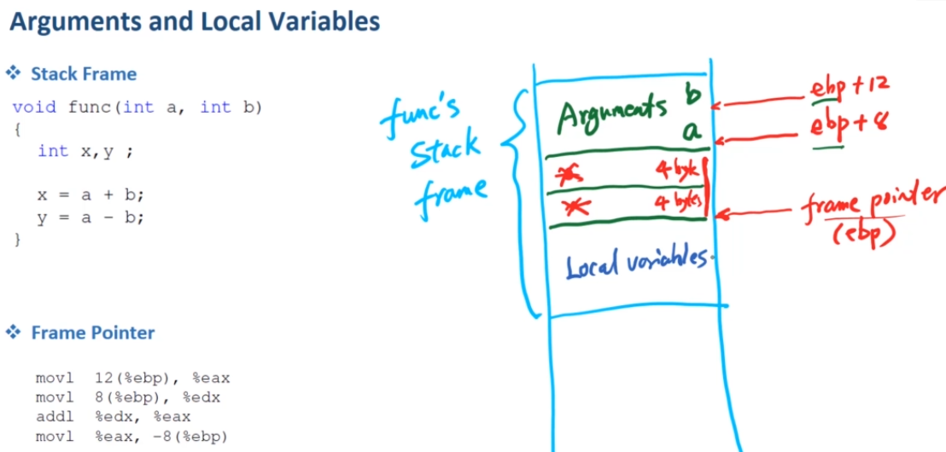
Stack Layout
  When a function invoked then there are 3 portions take place inside the stack frame
    Arguments (a , b) => How OS knows the address?
    Special region
    Local Variables
  During compilation difficult for the compiler to get the exact location of the variables.
  Compiler has no idea
  So the problem is solved by Using
  registers (ebp)
  We know, special region has Two
  portions (4, 4 bytes)
  Locations (easy for compiler now)
    a= ebp+8
    b= ebp+12

Slide 8
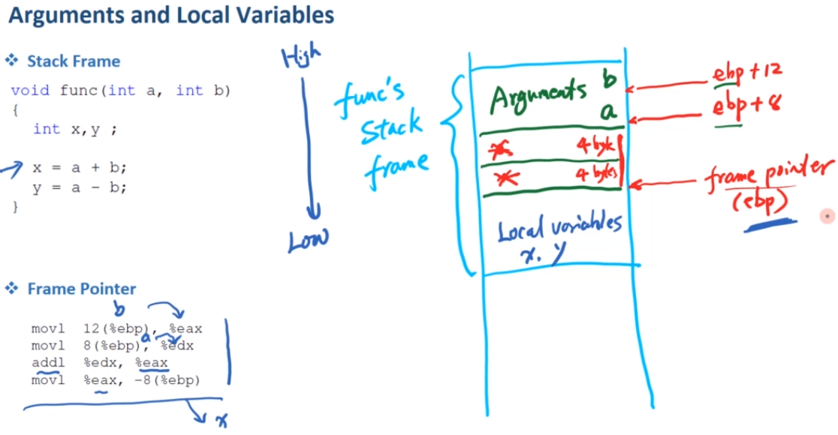
Stack Layout
  The diagram is explaining how the argument and local variables are working & get their locations.
  The assembly code is also given -8(%ebp) is for x variable

Slide 9
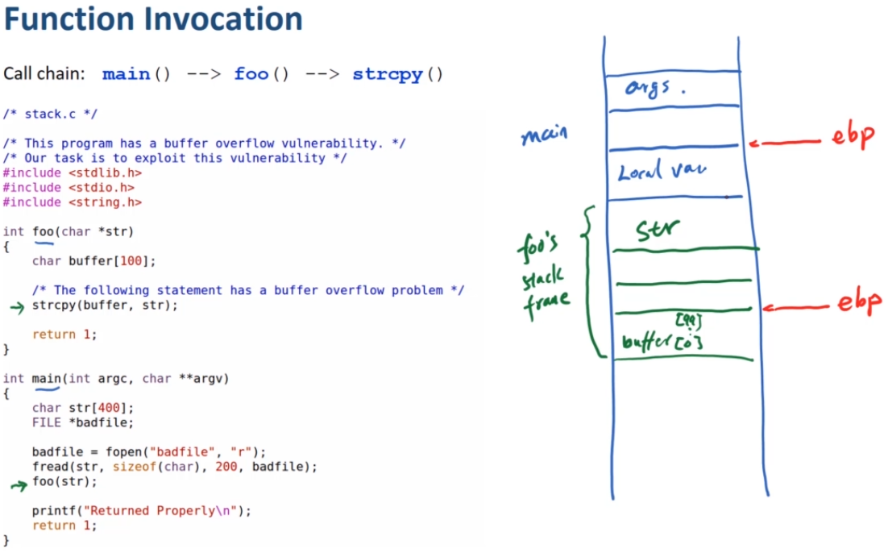
Function Invocation in Stack
  The main () program has function foo () → that has strcpy ()
  When main () invokes foo () then program allocates new block of space for foo().
  We also need ebp to point for the foo () special region but we have one ebp register.
  We need ebp here for pointing the foo() local variables & arguments

Slide 10
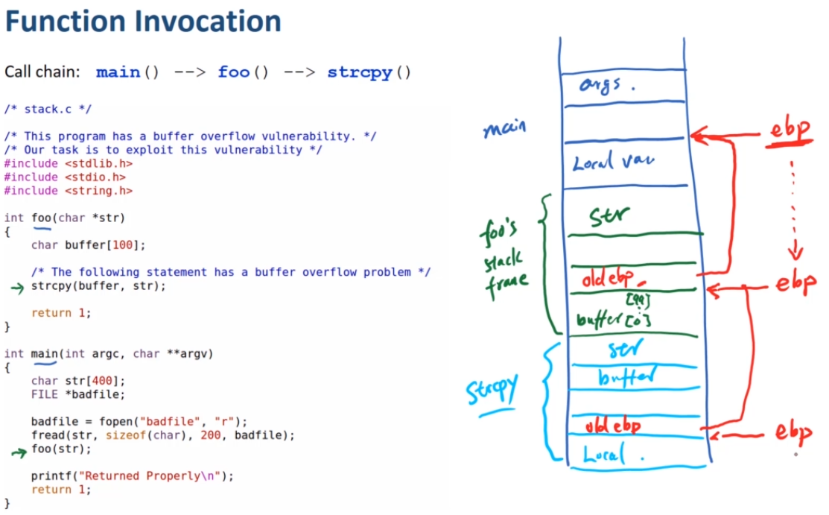
Function Invocation in Stack
  So we need to remember the value of ebp so properly pointing out the both venues.
    The first region of foo() store the value of ebp as (old ebp), so that it can point out the main()
  Inside foo() we also have strcpy, that also aquire a new block of space with two arguments.
  Same old ebp value
  Will be stored in
  strcpy ()

Slide 11
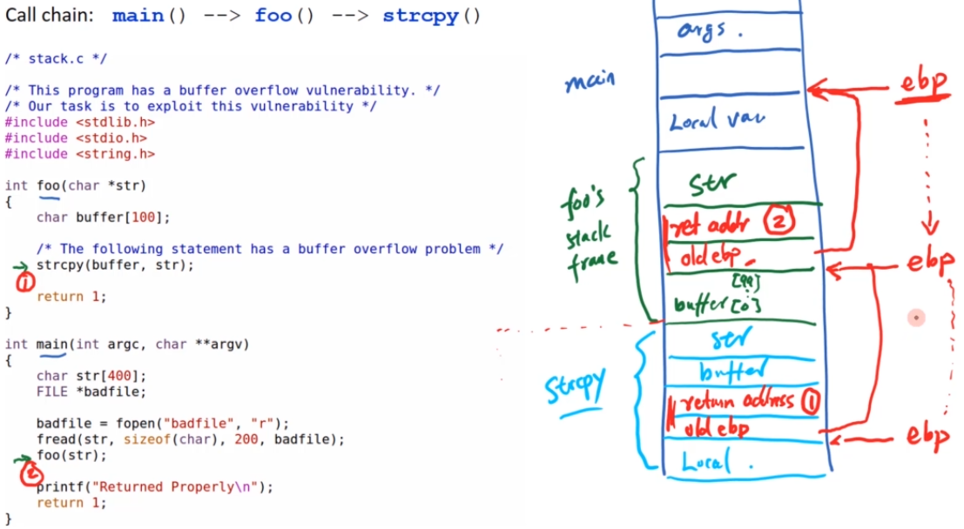
Function Invocation in Stack
  Keep in mind about the location, where you have to return from one location to the other
  Save return address of location 1
    strcpy() returns then we return to (1) → everything will be free & ebp jump to upper level
    Foo () return then we return to (2)→ everything will be free ebp jump up to main ()

Slide 12
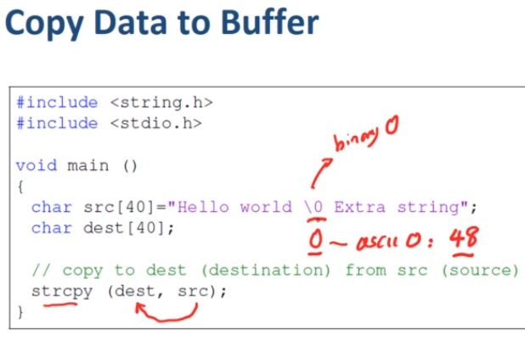
Buffer Overflow Vulnerability
  Here we are coping the data from src to dest. We don’t know how much data we have to copy in the ‘dest’.
  But one character can tell us i.e. 0
  \0 is the termination character
  If we remove \0 the compiler will copy the whole string and place \0 by itself at the end.

Slide 13
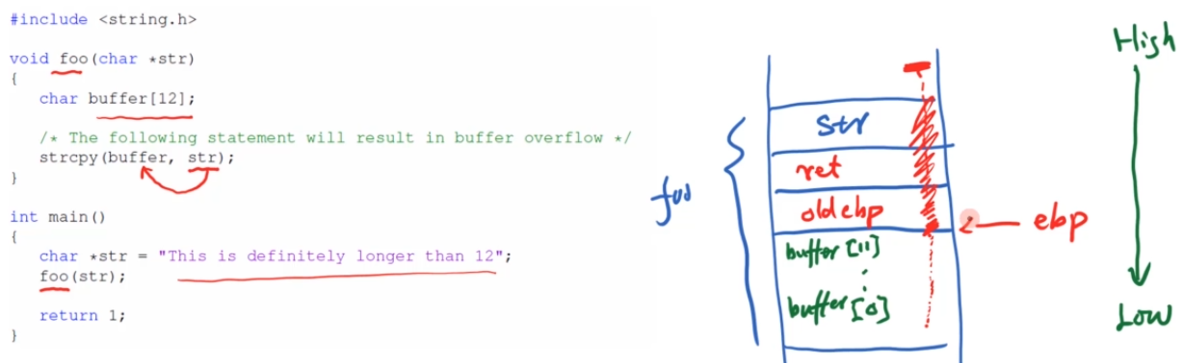
Buffer Overflow
  Foo() invoked in main() => foo() pass the str
  Foo() has local string in the function with size 12 but it copies str to buffer more than 12 characters
  So this buffer will overflow.
  Some persons think that data/buffer grows as the stack grows (High to low) → No (only stack grows)
  Whole string copied even outside the buffer portion until end but outside portion will be corrupted. Because of the buffer overflow
  Why the program crash?

Slide 14
Buffer Overflow Vulnerability
  Why the program crash?
  When buffer overflow the return value / addresses are replaced with your data that became outside the given space.
  So your address is not there then your program can crash.
  Two scenarios are there
  If you will jump to a virtual address that is not mapped with physical address then its invalid address → OS will kill that process
  Address mapped to invalid place so you may jump to invalid instructions → CPU will not recognize & kill that process
  If you have valid address but the area is restricted area such as OS kernel territory→ CPU won’t allow you to go there and your program crash.
  If you have no pointer address then your program will also crash.

Slide 15
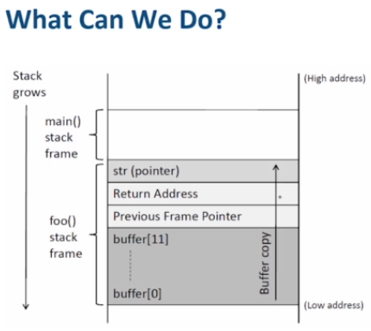
Buffer Overflow Vulnerability
  If it is a vulnerable program and a privileged program e.g. SET-UID program.
  Its running on server and we know that it has vulnerability. So what will be the damage?
  If we want to attack on this code , we will try that our code / malicious should be inserted in it so that we can damage it massively.
  How can attacker exploit buffer overflow vulnerability?

Slide 16
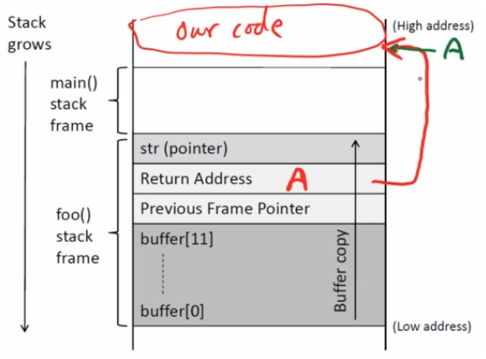
Buffer Overflow Vulnerability / Attack
  If we insert our malicious code at top and we are unable to get there → its dead code
  Most of the portion contains data in stack not code. But return address can lead us to code
  The idea of the damage is that we overflow the buffer and replace our data until the data replace the return address.
  We place the address of our code (A) with return address.
  So if we can run our code and we can do damage

Slide 17
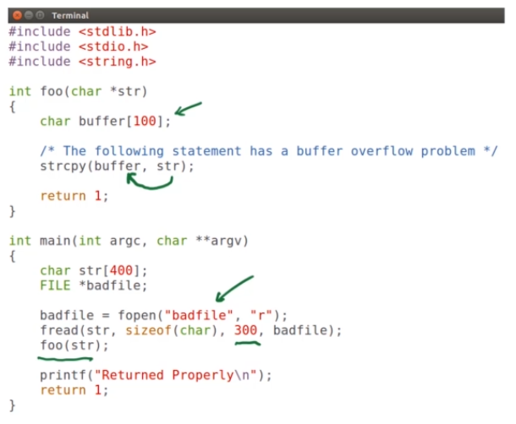
Buffer Overflow through Vulnerable program
  We can see how to launch attack…
  Set environment → a vulnerable program
  Buffer of size 100
  Main() gets input in a file ‘badfile’
  Main() going to read 300 characters from the
  File ‘badfile’
  Then invokes foo()
    Inside foo()→ copy 300 characters (str) to
    100 characters (buffer)
    Obviously there is buffer overflow
  This program is a SET-UID program
  Owned by root

Slide 18
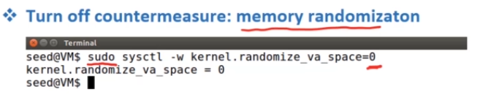
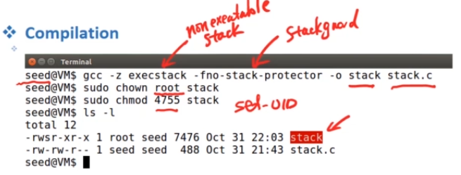
Experiment Setup
  Buffer overflow is one of the oldest vulnerability exists in software.
  In the VM, there are several countermeasures.
  Turn off some of them for this task
  Set memory randomization = 0 (off)
    You need to be root→ use sudo
  Now, compile the code and also turn off two other countermeasures
  Make it a privileged program→ change ownership & set SET-UID bit
  So, we have vulnerable-privileged program

Slide 19
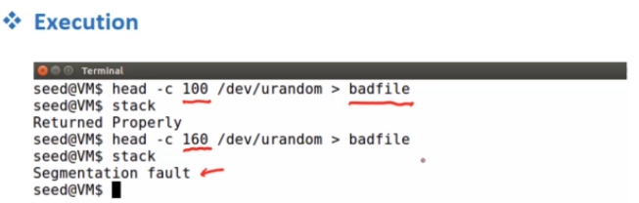
Buffer Overflow
  As the stack is taking input from ‘badfile’, so we are generating 100 bytes of random numbers and put into the ‘badfile’
    No problem will occur as the size of the buffer is 100
  Now, we tried again by generating 160 bytes of random numbers and put into the file.
  After executing the program, a fault message occur
    That means the Buffer Overflow →program crashes

Slide 20


